Slide 1
Keeping it Neat: Functions and JavaScript Source Files
Chapter 7

Slide 2

7.1
Functions

Slide 3
Built-In Functions
Built-in functions are like subprograms
They contain one or more parameters (a value to be sent to the function)
They return (send back to the program) at least one value
When a built-in function is called, the function name is assigned a value (of the type specified for that function)
A built-in function is called by using the function name anywhere in the program that a constant of its type is allowed
Some JavaScript global functions:
Function | Description
isFinite() | determines whether a value is a finite, legal number
isNan() | determines whether a value is an illegal number
parseFloat() | returns a floating point number
parseInt() | returns an integer
String() | converts an object's value to a string

Slide 4
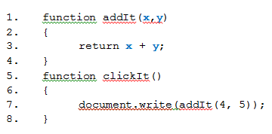
User-Defined Functions
Built-in functions return a single value to the program, such as:
age = parseInt(34.56);
age will have the value 34 after the statement is executed
You set the value of a variable (age) equal to the result of calling the function when the value you send it is 34.56
We can create that type of function ourselves: a user-defined function
Example: The output, after clicking a button to call clickit(), will be 9, the sum of 4 and 5

Slide 5
7.2
The Scope of a Variable

Slide 6
Global vs Local Variables
When a variable is input, processed, or output, we say that it has been referenced.
The scope of a variable refers to the part of the program in which a given variable can be referenced.
Global scope: If a variable is defined outside of all functions then the variable will exist from that point until the end of the program.
Local scope: any variable defined within a function will only exist while the function is running.

Slide 7
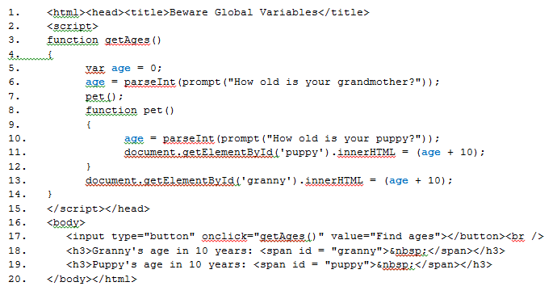
Beware the Global Variable!

Slide 8
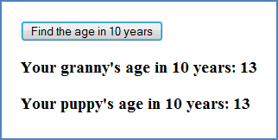
Results
If 105 is entered for your grandmother's age and 3 for your puppy's age, output would look as shown.
The value of age on line 6 is 105
It is changed on line 10 to 3
Since age has global scope within the getAges() function, it displays this value as requested on line 11
It retains this value even after the pet() function is exited
This is what is displayed when line 13 is executed.

Slide 9
Using Local Variables
The problem caused by a global variable can be fixed.
Changing the line from the previous program:
age = parseInt(prompt("How old is your puppy?"));
to:
var age = parseInt(prompt("How old is your puppy?"));
This fixes the problem! It creates a new variable, albeit with the same name (age) which is only local to the pet() function.

Slide 10
7.3
Sending Information to a Function

Slide 11
Arguments and Parameters
Functions often need to receive information from the statement that calls them. These values, sent to a function, are arguments.
The values in the parentheses in a function’s name are parameters.
Arguments can be variables, expressions, or values.
Parameters must be variables.
When sending an argument to a function, it must be the same data type as the parameter that receives it.

Slide 12
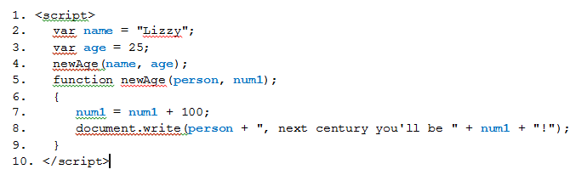
Passing Arguments to Parameters
The variables, name and age are the arguments that are passed to the parameters in the function newAge(). Note that the string variable, name, must be passed to the variable person and the numeric variable, age, must be passed to the variable, num1.
The output will be:
Lizzy, next century you’ll be 125!
If line 4 was written as: newAge(age, name); the output would be:
25, next century you’ll be NaN!

Slide 13
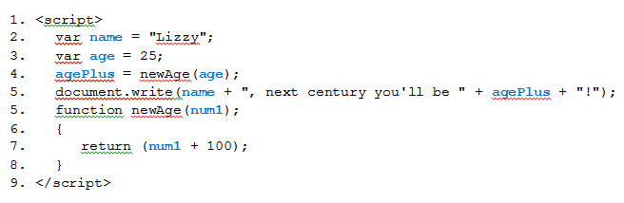
The return Statement
The return statement allows functions to send a value back to the expression or statement that called them.
A return statement can only return a single value.
This program takes the value of age (sent to the function) and returns a new value which is then used in the output.

Slide 14
Passing Values
When a variable is declared, a location in the computer's memory is identified.
When the name of that variable is used in the program, the computer goes to that location to retrieve the value.
If a variable named cars is assigned the value of 12 and a new variable, named trucks and is set equal to cars, then trucks has the value of 12 also.
Now two areas in the computer have the value of 12—one referenced by cars and the other referenced by trucks.
Anything done to cars to change its value will not affect the value of trucks.
This is the process that happens when a variable is passed by value.
The function that received the variable makes a new copy of that variable and manipulates the new copy. That's one way to pass variables in a program.
When a variable is passed by reference, the function receives the location in the computer's memory of the variable.
The variable in the function probably has a different name but the new variable points to the same location as the original variable.
From that point on, any changes made to the new variable change the value in the location and, therefore, change the original variable as well.

Slide 15
Value and Reference Parameters
Value parameters: Changes to their values in the function do not affect the value of the corresponding (argument) variables in the calling function. These parameters can only be used to import data.
Reference parameters: Changes in their values do affect the corresponding arguments in the calling function. They can be used to import data into and export data from a function.
In JavaScript,
primitive types are manipulated by value
numbers, booleans, and strings are considered primitive types in JavaScript
reference types are manipulated by reference
objects are considered reference types
arrays and functions, which are specialized types of objects, are also reference types

Slide 16
7.4
Objects and Object-Oriented Concepts

Slide 17
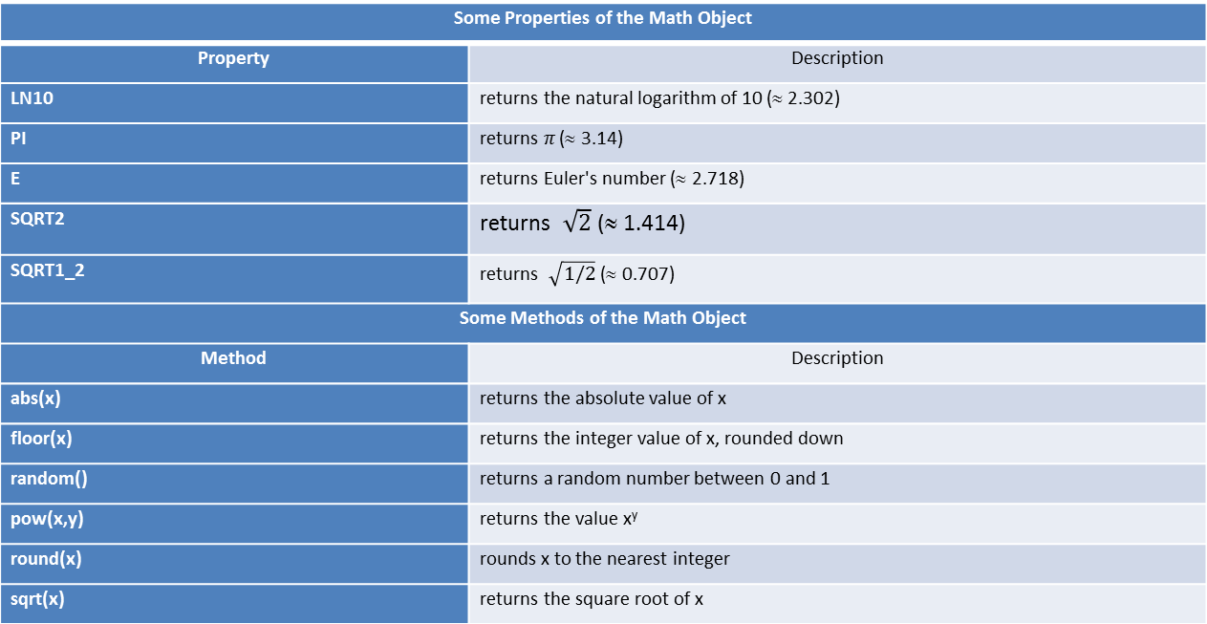
The Math Object Properties and Methods
Some Properties of the Math Object
Property | Description
LN10 | returns the natural logarithm of 10 (≈ 2.302)
PI | returns $π$ (≈ 3.14)
E | returns Euler's number (≈ 2.718)
SQRT2 | returns $\sqrt{2}$ (≈ 1.414)
SQRT1_2 | returns $\sqrt{1/2}$ (≈ 0.707)
Some Methods of the Math Object
Method | Description
abs(x) | returns the absolute value of x
floor(x) | returns the integer value of x, rounded down
random() | returns a random number between 0 and 1
pow(x,y) | returns the value x^{y}
round(x) | rounds x to the nearest integer
sqrt(x) | returns the square root of x

Slide 18
More JavaScript Objects
JavaScript Object | Description
Array | allows you to store multiple values with a single variable name
Boolean | allows you to convert a non-Boolean value to a Boolean (true/false) value
Date | used to work with dates and times
Math | allows you to perform mathematical tasks
Number | used for primitive numeric values
String | allows you to manipulate and store text

Slide 19
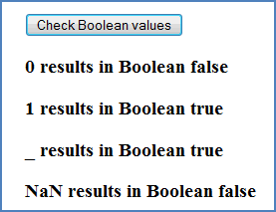
The Boolean Object
The program on the next slide creates four variables (one, two, three, and four) with various values.
Four instances of the Boolean object are created.
The values of each of the four variables are sent to the function that creates a new instance of the Boolean object.
The object turns the value into a Boolean value.
Since variables are passed by reference, the value of the initial variable remains the same.
If this program is coded and run the output will show that one still retains its initial value even though the Boolean object, bool1, now has the value of false.
The output shows that a 0 is a Boolean false, a 1 is a Boolean true, an underscore is a Boolean true, and NaN is a Boolean false.

Slide 20
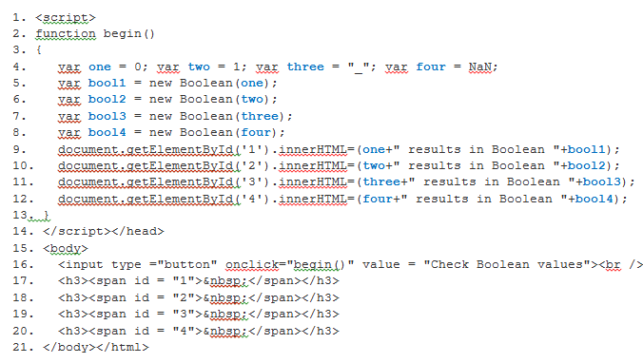
Boolean Objects

Slide 21
The Date Object
Some Methods of the Date Object
Some Methods of the Date() Object
Method | Description
getDate() | returns the day of the month (numerical, from 1 to 31)
getDay() | returns the day of the week (from 0 to 6)
getFullYear() | returns the year in four digits
getHours() | returns the hour (from 0 to 23)
getMinutes() | returns the minutes (from 0 to 59)
getMonth() | returns the month (from 0 to 11)
getTime() | returns the number of milliseconds since midnight January 1, 1970
getTimezoneOffset() | returns the time difference, in minutes, between the local time and Greenwich Mean time (GMT)
setDate() | sets the day of the month of a Date object
setFullYear() | sets the year, using four digits, of a Date object
setHours() | sets the hour of a Date object
setMonth() | sets the month of a Date object
setTime() | sets a date and time by adding or subtracting a number of milliseconds that you specify to or from midnight, January 1, 1970
toString() | converts a Date object to a string
toTimeString() | converts the time portion of a Date object to a string

Slide 22
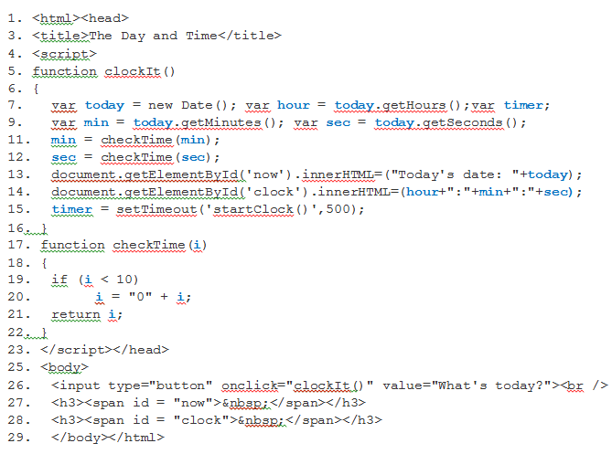
Using the setTimeout() Function to Create a Clock

Slide 23
7.5
JavaScript Source Files

Slide 24
Creating a Source File
Comparable to an external css file
Is a simple text file containing JavaScript functions
Use the .js extension
Use to create a library of functions
Link to the file in either <head> or <body>:
<script type="text/javascript" src="filename.js"></script>

Slide 25
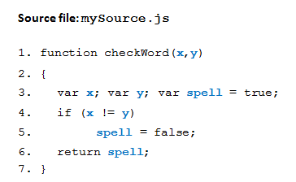
Creating a Source File
This example creates a source file which we will call mySource.js. It contains one function that will check whether a word is spelled correctly.

Slide 26
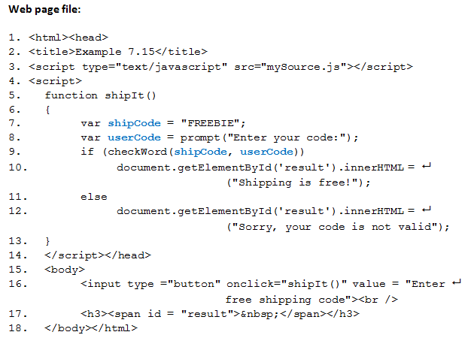
Using a Source File Checking if user enters a valid code

Slide 27
What happens?
shipIt() is called when the button is clicked.
it initializes a variable with the value of the free shipping code ("FREEBIE")
then prompts the user to enter his or her code
then it calls a function named checkWord().
If the checkWord() function returns true, line 10 is executed.
If checkWord() returns false, the else statement on line 12 is executed.
When checkWord() is called, the computer will look through the <head> section for a function named checkWord().
Since none is found, it goes to the .js file and looks for checkWord() there.
The variables, shipCode and userCode, are passed into the parameters of checkWord() which are x and y.
The function evaluates x and y, checking to see if they match.
If they don't, the variable spell is changed to false
if they do, spell remains as it was initialized, true.
This is returned to the shipIt() function and the program continues.

